Slide 1
Maximizing Ancillary
Product Results
MODERATOR
Brian Reed
PANELISTS
Tom Keepers
Sean Murphy

Slide 2
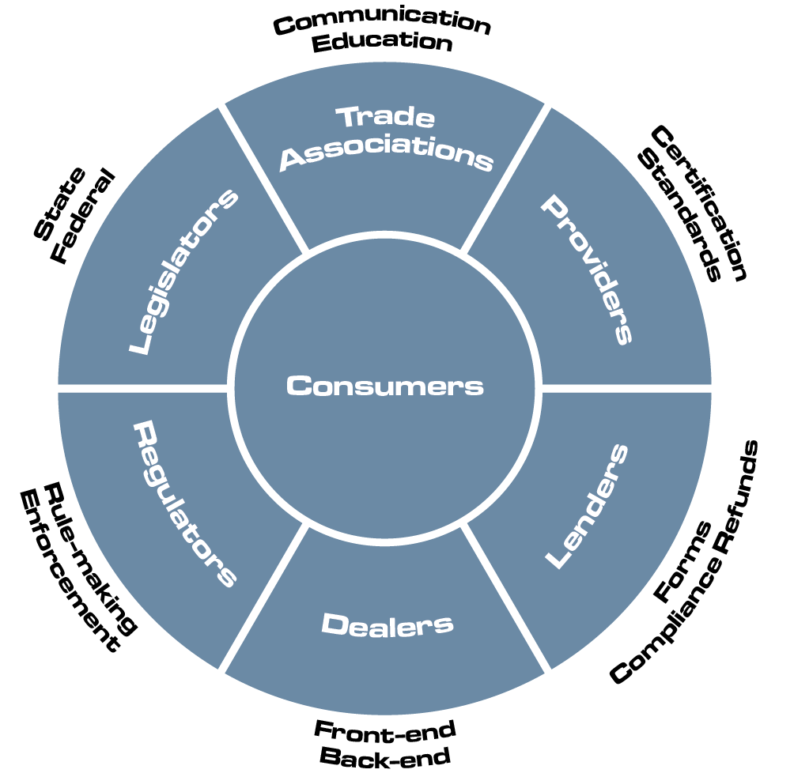
The Current Situation
The F&I product industry has many different stakeholders and represents a critical component of overall dealer profit today.
It is estimated that approximately 25% of dealer profit comes from F&I products.

Slide 3
Stakeholders Have Different Challenges
DEALERS
Training sales consultants to interact and sell F&I products to consumers in a compliant manner
Regulatory scrutiny and increased oversight – proposed CARS Rule
Growing F&I profit
Working with lenders and F&I providers on processes such as:
Evolving requirements of lenders in approving F&I product forms
Processing a growing number of F&I product cancellations due to early payoffs on GAP waivers and repossessions as well as customer-requested product cancellations
Multiple F&I providers (5-8) and multiple lenders (20-30), all with different processes

Slide 4
Stakeholders Have Different Challenges
F&I PROVIDERS
Increasing cancellations due to new regulatory requirements on lenders cancelling GAP waivers within 30-60 days of payoff
Dramatically increasing costs on lenders using third party for F&I product contract review
Estimated cost of over $100 million over the next three years
Each lender has different requirements to finance products
Evolving state and federal regulatory changes

Slide 5
Stakeholders Have Different Challenges
LENDERS
Significant regulatory actions, fines, legal actions, and settlements related to refund and cancellation processes
Understanding who all the F&I providers are, their business practices, and products they offer to dealers
Regulatory changes, especially regarding requirements to provide consumers a refund of unearned GAP waiver premiums within 30-60 days of payoff, depending on the state
Interacting with thousands of dealers they do business with, plus the several hundred F&I providers that the dealers use without any technology to connect them all
It is estimated that the process cost of F&I product cancellations right now is over $100 million annually

Slide 6
Summary
Lenders, dealers, and F&I providers all have process, regulatory, and operating costs challenges related to F&I products
The lack of any technology that links stakeholders together creates challenges for all that results in massive costs to process F&I products and ensure compliance
Lenders work with dealers and dealers work with F&I providers, but there is limited interaction between all three
To deliver the best overall consumer experience, all three parties need to work together, and antitrust oversight is critical

