Slide 1
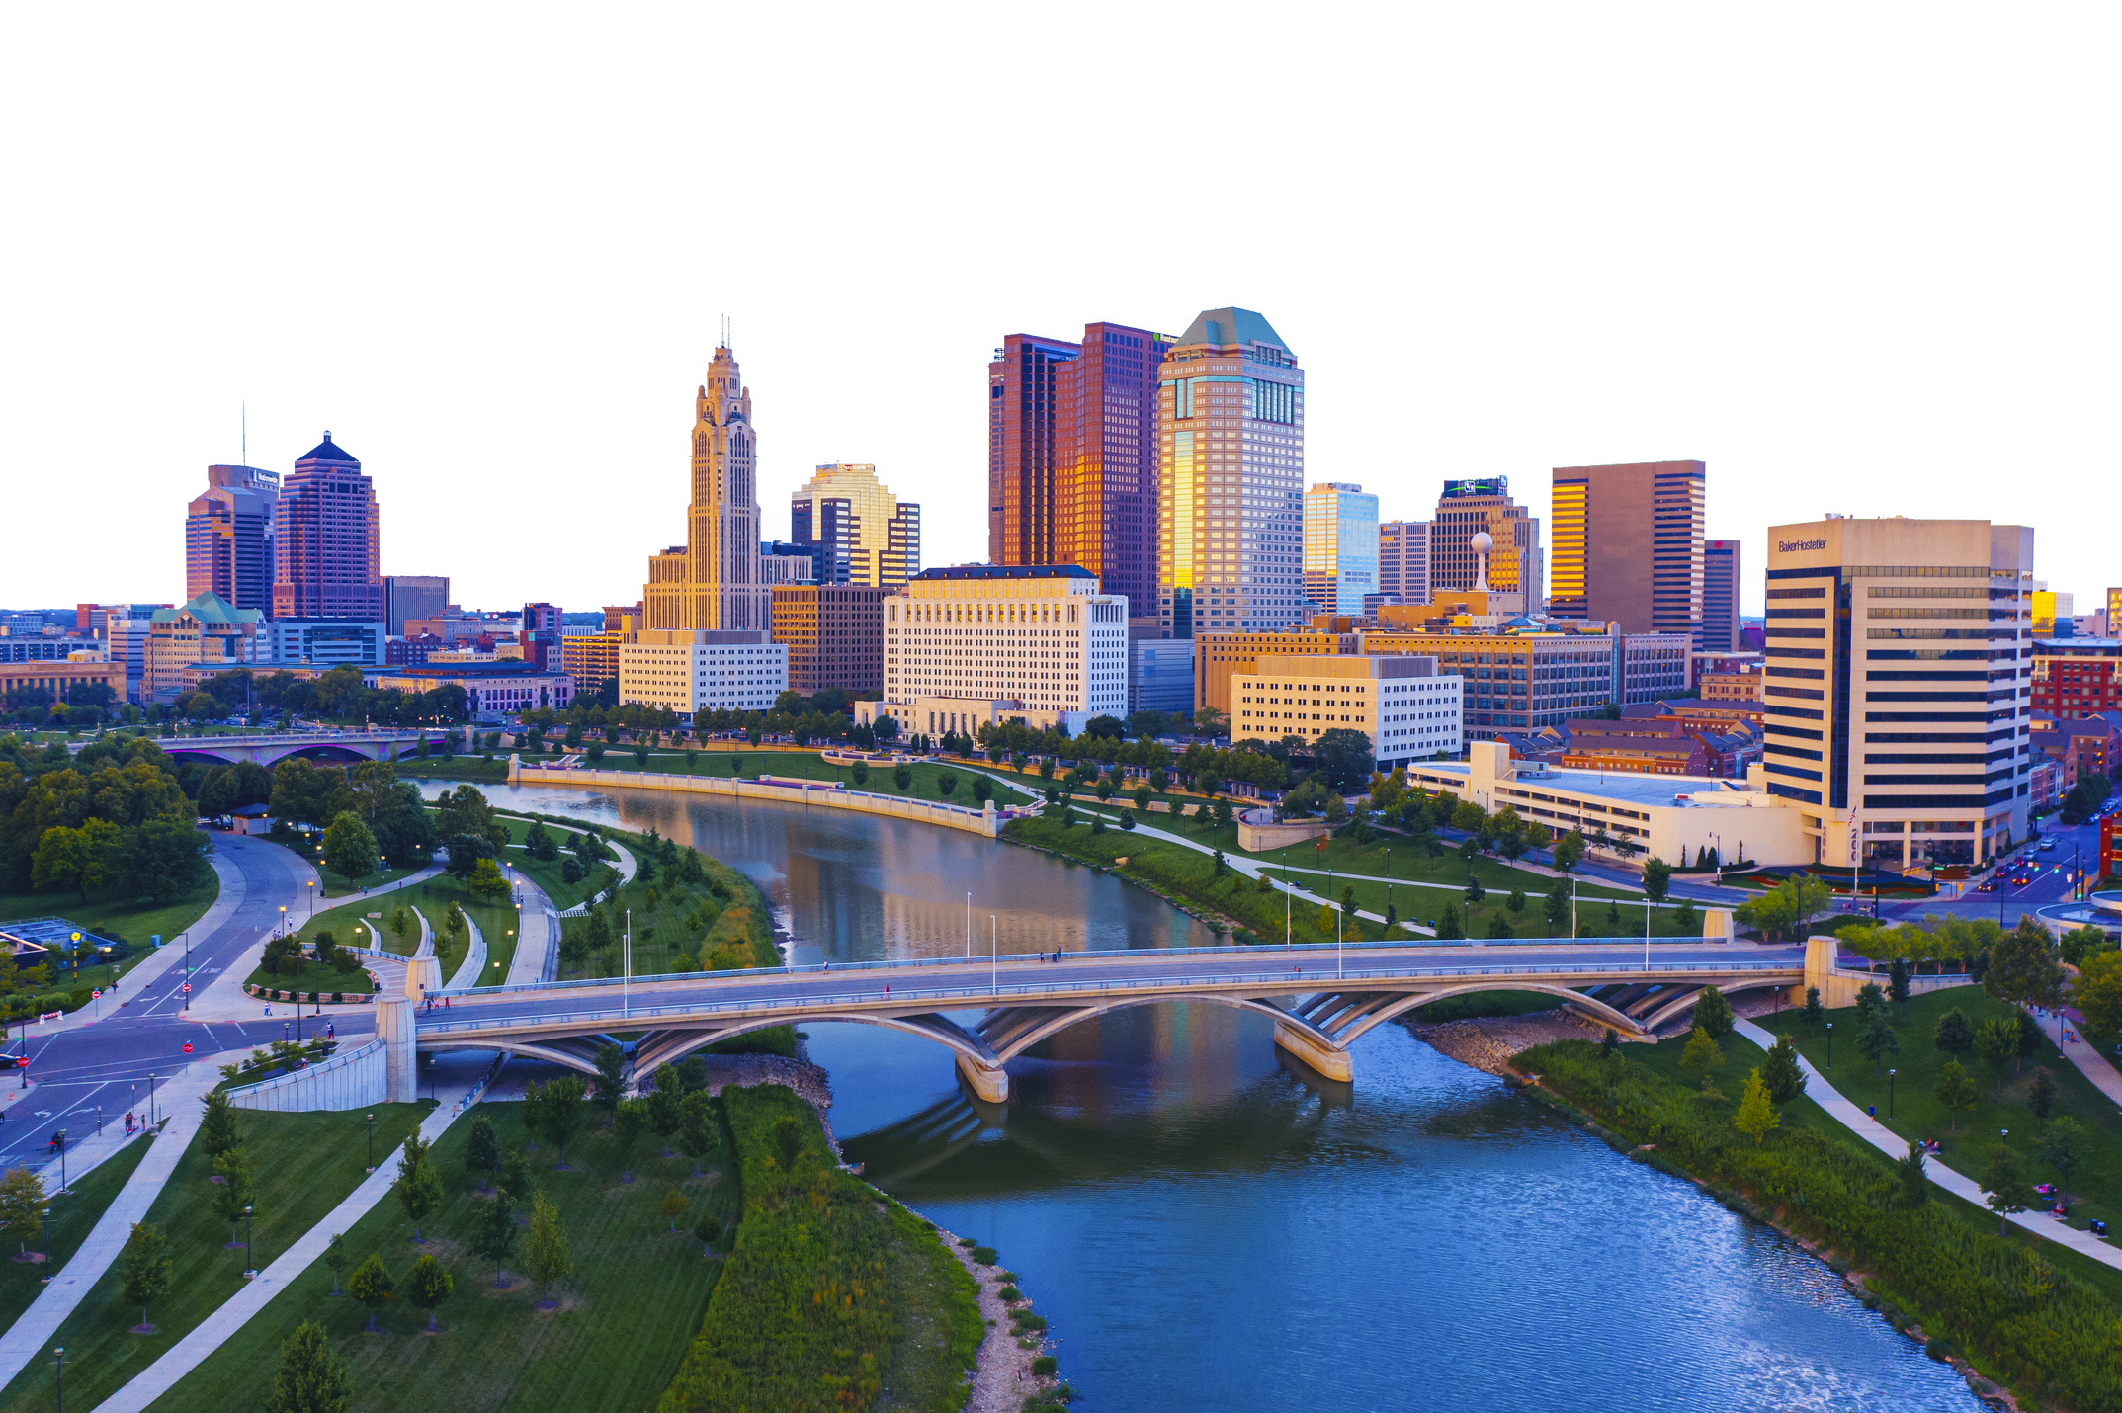


September 23-24 // Sonesta Columbus Downtown
Let’s connect at #PSFS25
2025 SPONSOR

